Slide 1
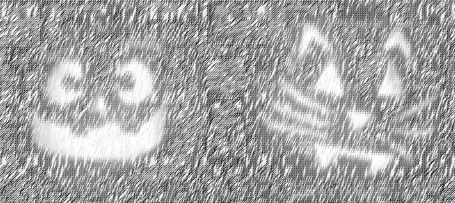
Introduction to Statistics – Day 2
GMS Statistics Programme
Justin Whalley

Slide 2
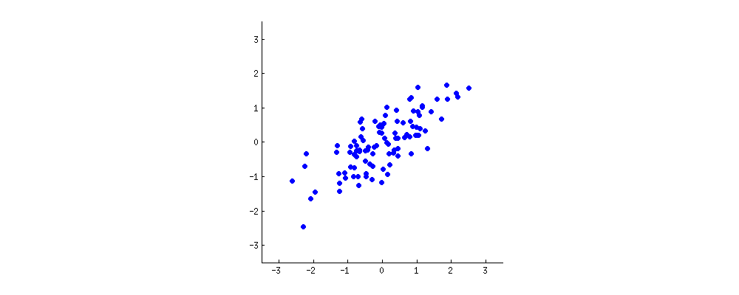
PCA: defining components
https://stats.stackexchange.com/questions/2691/making-sense-of-principal-component-analysis-eigenvectors-eigenvalues
Notes:
Looking at two characteristics of a our dataset (x and y). Want to reduce it from 2D to 1D.
A new property can be constructed by drawing a line through the centre of this cloud and projecting all points onto this line. This new property will be given by a linear combination w1x+w2y, where each line corresponds to some particular values of w1 and w2.

Slide 3

PCA: defining components
https://stats.stackexchange.com/questions/2691/making-sense-of-principal-component-analysis-eigenvectors-eigenvalues
Notes:
PCA will find the "best" line according to two different criteria of what is the "best". First, the variation of values along this line should be maximal. Pay attention to how the "spread" (we call it "variance") of the red dots changes while the line rotates; can you see when it reaches maximum? Second, if we reconstruct the original two characteristics (position of a blue dot) from the new one (position of a red dot), the reconstruction error will be given by the length of the connecting red line. Observe how the length of these red lines changes while the line rotates; can you see when the total length reaches minimum?

Slide 4
PCA on highly correlated data
Notes:
When we have a high correlation, reducing the dimensions makes sense (in this case the PCA component one explains a high percentage of variance of the dataset).

Slide 5
PCA on uncorrelated data
Notes:
However when we have low level of correlation, we are less successful in reducing the dimensions, in this case both components tend to explain the same amount of variance of the dataset.
We rarely would use PCA on a two dimensional dataset, lets look instead a gene expression experiment.

Slide 6
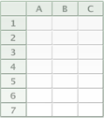
Pilot data gene expression
donor
genes
Non-treated, ‘naive’,
monocytes
Notes:
In this dataset we have:
228 donors, ~15000 gene expression values

Slide 7
Pilot data gene expression
donor
genes
Naive
IFNγ treated
monocytes
Notes:
Gene expression for the monocytes treated by inteferon-gamma – proteins that help regulated the immune system.

Slide 8
Pilot data gene expression
donor
genes
Naive
IFNγ
Lipopolysaccharide (LPS) treated
monocytes (2 hour wait)
Notes:
Major component of the outer wall of gram negative bacteria, which our body registers as a toxin and elicits a strong immune response.

Slide 9
Pilot data gene expression
donor
genes
Naive
IFNγ
LPS 2h
Lipopolysaccharides (LPS) treated
monocytes (24 hour wait)
Notes:
Also gene expression after 1 day of being treated.

Slide 10
Pilot data gene expression
donor
genes
Naive
IFNγ
Treatment
LPS 2h
LPS 24h
Notes:
So we have a dataset for 912 samples, gene expression data for ~15,000 genes.

Slide 11
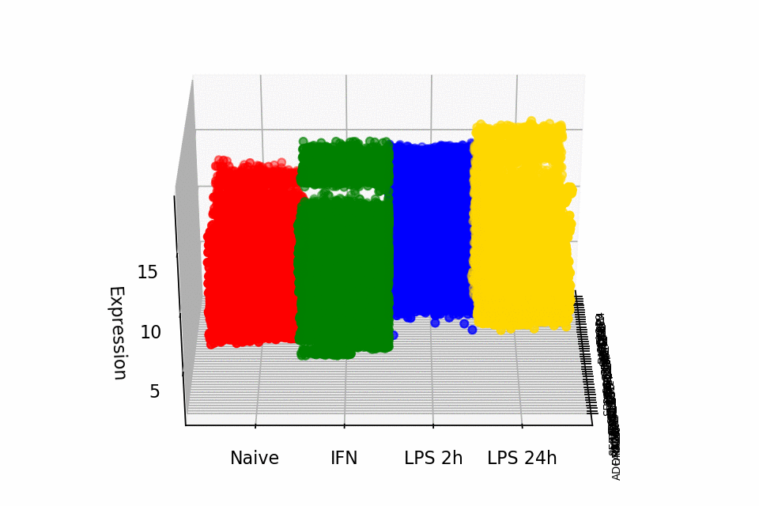
Notes:
No doubt there is high redundancy amongst the samples, so reducing them from 912 to a smaller number could be really helpful into interpreting the dataset (in this case for projecting the gene expression and genes into one value for each sample for each principal component).

Slide 13
Subsections within the data
donor
donor
genes
 | D | N | F
238
3492
genes
Naive
IFN
LPS
2h
donor
Treatment
LPS
24h
 | X | Z
9402
543
13223
genes
Notes:
PCA picks out what is causing the greatest amount of variance.
What about looking for interesting modules within the larger dataset - other than what the cells had been treated with?

Slide 14
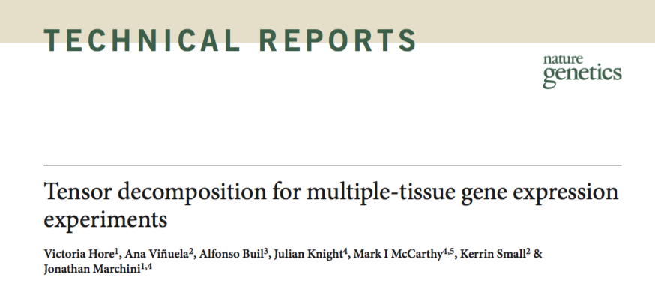
Tensor decomposition
Notes:
Tensor decomposition fits our requirements - there is specific software for gene expression data (published 2016).

Slide 15
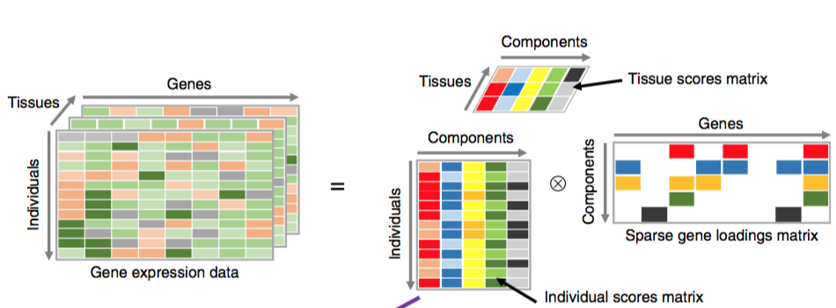
Tensor decomposition
Notes:
Graphical representation of the method.
The gene expression data tensor (top left) is decomposed into the product of an individual scores matrix, a tissue scores matrix and a gene loadings matrix (top right).

Slide 16
donor
Treatment
Treatment
genes
genes
donor
genes
Naive
IFN
Component 1
Component n
LPS
2h
Treatment
LPS
24h
Notes:
So in my case, around 500 components at 3000 iterations.
Each component in genomic _{subspace} represents a coherently functioning genomic module or noise (experimental or otherwise)
This takes around 1600 cpu-hours
How robust is each component?

Slide 17
donor
Treatment
Treatment
genes
genes
donor
genes
Naive
IFN
Component 1
Component n
LPS
2h
Treatment
10 times
LPS
24h
Component 1
Component m
Notes:
To deal with the robustness, repeat the tensor decomposition 10 times, each time for 500 components, losing around 40 ‘zero’ components

Slide 18
donor
genes
Naive
IFN
LPS
2h
Treatment
LPS
24h
Notes:
Hierarchal clustering of all the components, using 1 - pearson’s correlation coefficient as the distance measure. Cutting off the clusters at 0.4.
Keeping the average cluster for any cluster with components that appear in five or more runs.

Slide 19
donor
genes
Treatment
Treatment
genes
donor
genes
donor
Naive
Component 1
Component 176
IFN
LPS
2h
Treatment
LPS
24h
Notes:
Hierarchal clustering of all the components, using 1 - pearson’s correlation coefficient as the distance measure. Cutting off the clusters at 0.4.
Keeping the average cluster for any cluster with components that appear in five or more runs.

Slide 20
Notes:
Look at component 109
No difference between the different treatments in this component. However...

Slide 21
Naive
IFN
LPS 2h
LPS 24h
Notes:
In component 109 our samples are separated into two...

Slide 22
Naive
IFN
LPS 2h
LPS 24h
Notes:
Expression all the same, samples separated into females and males.
Expression of genes on x and y chromosomes.

Slide 23
Notes:
Different response between IFN and LPS 24h?

Slide 24
Naive
IFN
LPS 2h
LPS 24h
Notes:
Big difference in first 130 samples, compared to later 90 samples.
Labelled where it happens 288 and 289. Time batch effect? When were they processed? in 2010 and 2012 respectively.

Slide 25
Naive
IFN
LPS 2h
LPS 24h
Notes:
Expression of CD14 most interesting (and interleukin genes).

Slide 26
Notes:
CD14 has very varied expression for the early group and tight expression for the late group.
Expression very different in the IFN and especially the LPS 24 group.
We got better at isolating CD14 positive cells? Better antigens? More experience? Better protocol?

